Slide 1
Discussion

Slide 2
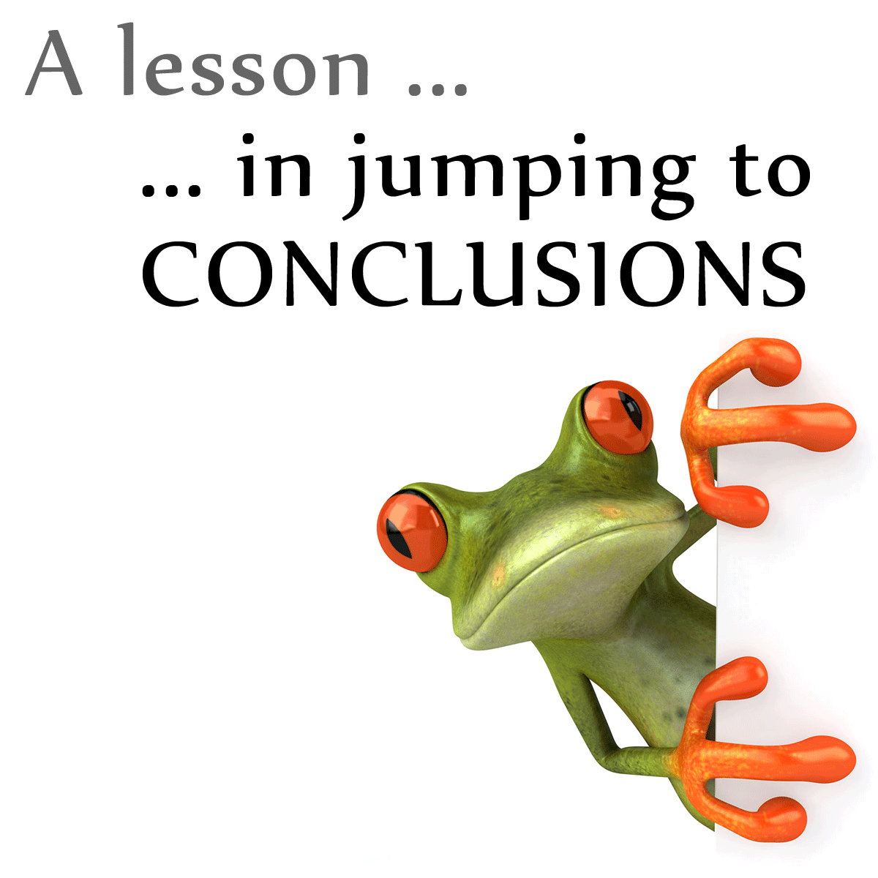
Discussion

Slide 3
DISCUSSION Assessment criteria Rubric
Structured according to the inverted funnel model (from specific to general)
Conclusions relate back to the central question
Conclusions supported by results/theories presented and linked to theoretical framework presented in introduction
Interpretation of findings is provided, explaining what findings mean for existing theories and practice (substantiated with references)
Critical reflection on current literature review (what remains unclear? Limitations of described studies?)
Critical reflection on limitations of student’s own literature review
Relevant and substantiated suggestions for follow-up research
Clear closing message
Notes:
In the discussion section you give an answer to the central question based on the main findings you described in the main body of your text. This is followed by a critical discussion of the findings (the discussion), which should include your assessment of the connections, shortcomings, obscurities, inconsistencies, and contradictions in the report. The critical discussion should see you make suggestions for follow-up research, indicating where exactly future studies should focus. You should conclude this section by placing the answer to the question in a broader context by discussing its implications on theory and practice.
The conclusion/discussion section should be shaped like a inverted funnel. Contrary to the introduction, which sees you narrow the subject down the question, here you take the answer and widen its scope.
All issues you raise in the discussion are also featured in the main body, so it shouldn't contain any new information. Then why don't we qualify this as a mere summary? Because it's more than just that. It is a critical appraisal, i.e. you should go deeper into the information presented and discuss what criticism of this might be raised and also highlight the strong points of certain studies. To do this, you'll sometimes need some extra information. Strictly speaking this would qualify as new information (as it is not featured in the main body), but it doesn't add content that answers the question.
In addition, you would obviously also cite your sources here, too. Anything you introduce that you haven't come up with yourself, should be referenced. The fact that this might involve you citing the same source over and over, is irrelevant, as long as the reader knows where the information was sourced.
Discussions can quite easily become blurry. What could help is to stick to the structure you employed in the main body and use it for your discussion. However, your discussion might, for example, focus on several issues of methodology. In that case, you might be discussing problems with measuring methods and the studies affected by this in one paragraph, moving on to the taking of samples that were too small in the next. As long as you maintain clarity for the reader. So, here too, try and employ structural indicators to help the reader.
Tip: Read the discussion of the articles you are using for your report, here the authors themselves indicate the limitations of their research

Slide 4
Pitfalls
Central question is not repeated
Conclusion isn't sufficiently substantiated
Critical discussion lacks depth
- Not enough criticism
- Irrelevant criticism
Suggestions for follow-up research:
- Not specific enough, not relevant
No implications for theory/practice
Notes:
The discussion section is one of the hardest components to write.
Students often have trouble substantiating their conclusion, critically discussing the findings, offering suggestions for follow-up research and discussing implications on theory and practice.
When supporting your conclusion, you'll want to clearly indicate how the main findings you described in the main body affect the central question. You'll have to interconnect these findings, i.e. don't just summarise them, but integrate them.
In the critical discussion section, students are often found to have difficulty in coming up with points of criticism to the information they discussed in the main body. Being aware of what the standard issues are to look out for in the critical appreciation of research can help. You may also find it useful to employ the critical notes the researchers added to their studies (you'll find these in the discussion section of the article).
When offering suggestions for follow-up research, students have shown a tendency to offer general directions, yet the idea is to make specific suggestions as to where future research should focus.
Finally, student are often also found to not even discuss the implications on theory and practice.

Slide 5
CONCLUSION - Example of substantiated answer to the question
Relation between attentional bias and addiction
"This report maps the relation between attentional bias and addiction. Literature has shown that the attentional bias can play a role in the maintenance of addictions. It appears that the bias and the subjective desire for drugs interact (Field & Cox, 2008). Whenever an addict is confronted with stimuli related to his addiction, both the craving for drugs as well as the attentional bias increase (Field & Eastwood, 2005). …”
Notes:
Here are some examples to illustrate what a good/bad conclusion and discussion looks like.
What do you think about this conclusion? Is this a good or a bad conclusion/discussion section?

Slide 6
CONCLUSION - Good Example
Relation between attentional bias and addiction
"This report maps the relation between attentional bias and addiction. Literature has shown that the attentional bias can play a role in the maintenance of addictions. It appears that the bias and the subjective desire for drugs interact (Field & Cox, 2008). Whenever an addict is confronted with stimuli related to his addiction, both the craving for drugs as well as the attentional bias increase (Field & Eastwood, 2005). …”
It features a clear question, a clear answer and substantiation (incorporating the main findings)
Notes:
This a good example: The question is clearly outlined, with a clear answer and substantiation provided to it. Plus, it doesn't merely summarise the main findings, but integrates these with each other (the interaction between the bias and the subjective desire for drugs is evidenced by two sources).

Slide 7
DISCUSSION - Example limitation
Effect of laughing on physical health
"…In studies researching the effect of laughing on physical health, the question that remains is whether the effect measured is caused only by laughing, or, perhaps, also by other factors. Furthermore, the difference between men and women should also be taken into account. Blood pressure in men differs from that of women during laughing, for example (Martin, 2001). ..."
Notes:
Is this a good or a bad example of a discussion?

Slide 8
DISCUSSION - Good Example
Effect of laughing on physical health
"…In studies researching the effect of laughing on physical health, the question that remains is whether the effect measured is caused only by laughing, or, perhaps, also by other factors . Furthermore, the difference between men and women should also be taken into account. Blood pressure in men differs from that of women during laughing, for example (Martin, 2001). …”
Good connotations and source
What other factors could also have an effect?
Notes:
This a good example: Connotations are made (perhaps other factors are also involved and differences between men and women have also been found).
A downside to this assessment is that it doesn't specify which factors might have an effect.

Slide 9
DISCUSSION - Example suggestion for follow-up research
"This literature study has led to the conclusion that there is no specific cause for the manifestation of eating binges in patients with anorexia nervosa. These are always caused by a multitude of factors. Follow-up research could focus on this combination of factors."
Notes:
Is this a good or a bad example of a suggestion for follow-up research?

Slide 10
DISCUSSION - Mediocre example
"This literature study has led to the conclusion that there is no specific cause for the manifestation of eating binges in patients with anorexia nervosa. These are always caused by a multitude of factors. Follow-up research could focus on this combination of factors.
Not specific enough!
Notes:
This is a mediocre example of a suggestion for follow-up research. It lacks specificity in indicating where future research should focus on. The author should have specifically mentioned which combination of factors should be studied.

Slide 11
DISCUSSION - Example suggestion for follow-up research
"It could be interesting to investigate whether the intrinsic motivation of students can be enhanced by the use of social media in education."
Notes:
Another example of a suggestion for follow-up research...
Is this a good or a bad example?

Slide 12
DISCUSSION - Good Example
"It could be interesting to investigate whether the intrinsic motivation of students can be enhanced by the use of social media in education."
Sufficiently specific!
Notes:
This a good example: This example includes a tangible proposal for follow-up research.

Slide 13
DISCUSSION - Example implications for practice
The above findings suggest that the manifestation and sustainment of alcohol abuse is related to the imbalance between the impulsive system and the regulating reflective system. This theoretical insight offers new possibilities to the practical applications of addiction treatments. Current forms of treatment could be augmented by the interventions aimed at 'restoring' the imbalance between both systems.
Notes:
This an example of how you could offer an implication to practice.
The example summarises the main findings and translates these into practical recommendations.
When you ponder the practical implications of something, you'll want to think of how your conclusions can be transferred into practical solutions.

Slide 14
Tips Discussion
Read the discussion of the articles you are using for your report, here the authors themselves indicate the limitations of their research
Have a look at the sample reports on Canvas and other review articles
How is the discussion structured?
How does the author link the critical discussion of the findings to the research question and the theoretical framework offered in the introduction?

